Slide 1


Information and Network Security
Ms. Hansa Vaghela , Assistant Professor
Computer Science & Engineering

Slide 2

CHAPTER-2
Classical Encryption Techniques

Slide 3
Outline
Symmetric Cipher Model
Substitution Techniques
Transposition Techniques
Steganography

Slide 4
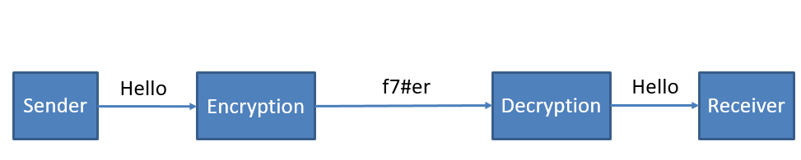
Encryption and Decryption
Encryption and Decryption^{[2]}

Slide 5
Terminologies
Plaintext: original message
Cipher text: encrypted or coded message
Encryption: convert from plaintext to cipher text (enciphering)
Decryption: restore the plaintext from cipher text (deciphering)
Key: information used in cipher known only to sender/receiver
Cipher: a particular algorithm (cryptographic system)
Cryptography: study of algorithms used for encryption
Cryptanalysis: study of techniques used for decryption without knowledge of plaintext
Cryptology: areas of cryptography and cryptanalysis

Slide 6
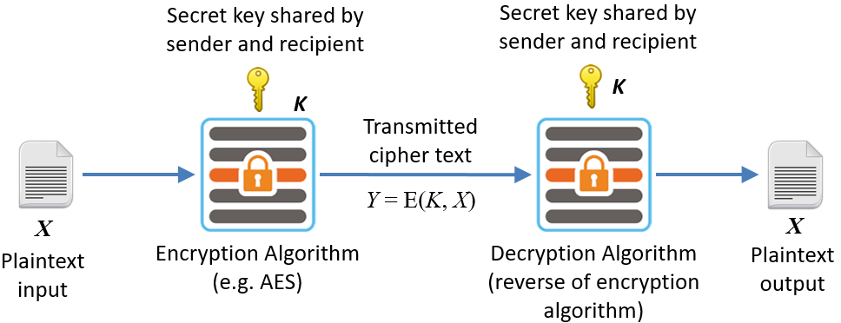
Symmetric Cipher Model (Conventional Encryption)
An original message is known as the plaintext, while the coded message is called the cipher text.
Symmetric Cipher Model ^{[4]}

Slide 7
Symmetric Cipher Model (Conventional Encryption)
The process of converting from plaintext to cipher text is known as enciphering or encryption; restoring the plaintext from the cipher text is deciphering or decryption.
Plaintext is the original intelligible message or data that is fed into the algorithm as input.
Encryption algorithm performs various substitutions and transformations on the plaintext.
Decryption algorithm is essentially the encryption algorithm run in reverse.
It takes the cipher text and the secret key and produces the original plaintext.

Slide 8
Symmetric Cipher Model (Conventional Encryption)
Two requirements for secure use of conventional encryption.
1. we need a strong encryption algorithm. At a minimum, we would like the algorithm to be such that an opponent who knows the algorithm and has access to one or more cipher texts would be unable to decipher the cipher text or figure out the key.
This requirement is usually stated in a strong form: The opponent should be unable to decrypt cipher text or discover the key even if he or she is in possession of a number of cipher texts together with the plaintext that produced each cipher text.

Slide 9
Symmetric Cipher Model (Conventional Encryption)
Sender and receiver must have obtained copies of the secret key in a secure fashion and must keep the key secure. If someone can discover the key and knows the algorithm, all communication using this key is readable.

Slide 10
Symmetric Cipher Model (Conventional Encryption)
Plain text X=[x1,x2,x3...]
Key K=[k1,k2,...]
Cipher text Y=[y1,y2,...]
Encryption
Y=E(K,X)
Decryption
X=D(K,Y)

Slide 11
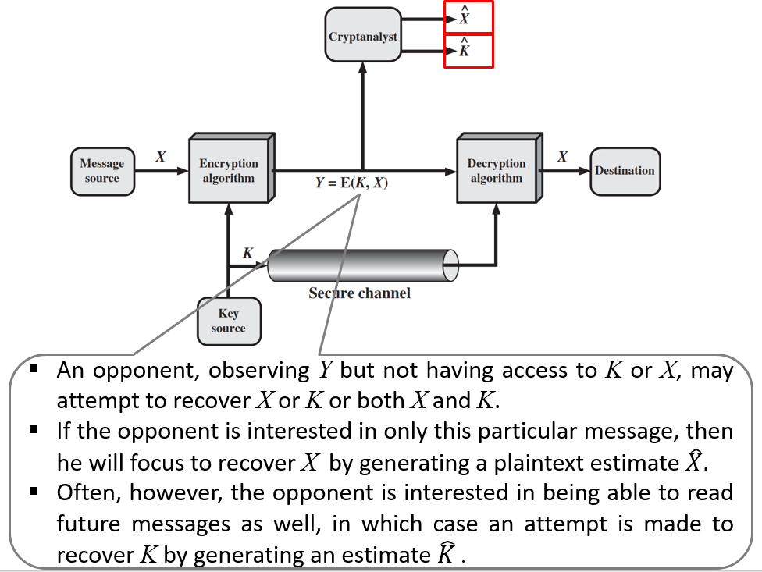
Symmetric Cipher Model (Conventional Encryption)
Symmetric Cipher Model^{[3]}

Slide 12

Cryptography and Cryptanalysis
Cryptography(Secret Writing) is the process of protecting information by transforming it into a secure (unreadable) format.
Cryptanalysis is the decryption and analysis of encrypted text. Cryptanalysis uses mathematical formulas to search algorithm vulnerabilities and break into cryptography.
Cryptography^{[2}}
Cryptanalysis^{[2]}

Slide 13
Cryptography
Cryptography is the study of mathematical techniques related to aspects of information security such as confidentiality, data integrity, and entity/data origin authentication.
Characterized in three dimensions:
Type of operation used
1) Substitution : Elements of plaintext are mapped into another element
2) Transposition : Elements of plaintext are rearranged

Slide 14
Cryptography
The Number of keys used
1) Symmetric, Single-key, Secret-key, Conventional Encryption: Same Key is Used
2) Asymmetric, two-key, Public-key : different keys are used
Way in which the plaintext is processed
1) Stream Cipher : processes the input elements continuously, producing output one element at a time.
2) Block Cipher : processes the input one block of elements at a time, producing an output block for each input block.

Slide 15
Cryptanalysis
Cryptanalysis is the study of mathematical techniques for attempting to defeat cryptographic techniques that provide information security services.
Cryptanalysis means “breaking the code”.
Techniques used for deciphering a message without any knowledge of enciphering details fall into the area of cryptanalysis.

Slide 16
Cryptanalysis
Typically, the objective of attacking an encryption system is to recover the key in use rather then simply to recover the plain text.
Two approaches:
cryptanalytic attack
brute-force attack

Slide 17
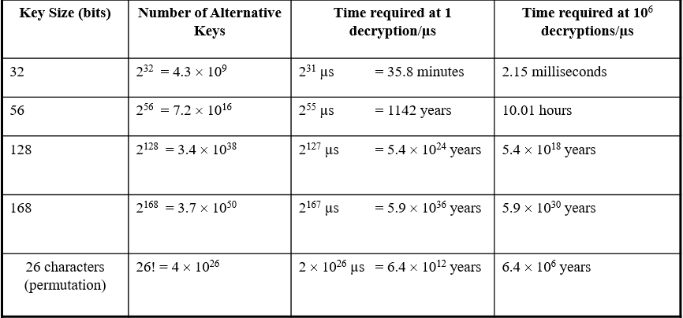
Cryptanalysis
Brute-force attack
A brute-force attack involve trying every possible key until an intelligible translation of the cipher text into plaintext is obtained.
Brute force attack^{[2]}

Slide 18
Cryptanalysis
Cryptanalysis attacks
Cryptanalysis attacks rely on
the nature of the algorithm plus
some knowledge of the general characteristics of the plain text or even some sample plaintext-cipher text pairs.
This type of attack exploits the characteristics of the algorithm to attempt to deduce a specific plaintext or to deduce the key being used.

Slide 19
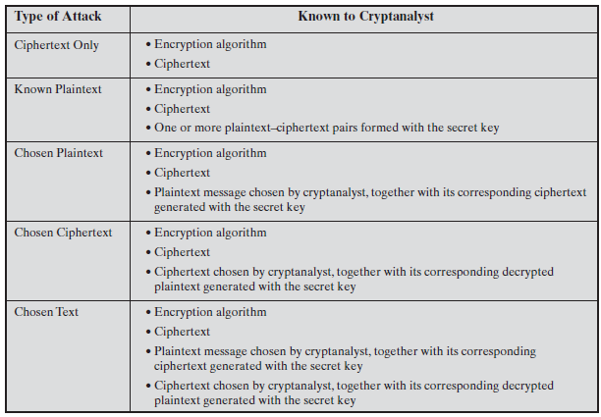
Types of Cryptanalysis Attacks
Types of Attacks^{[3]}

Slide 20
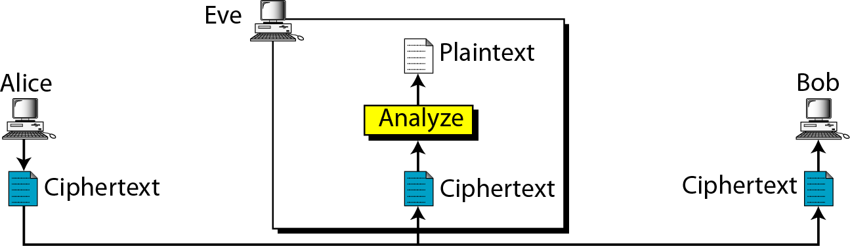
Attacks on Encrypted Messages
Type of Attack | Known to cryptanalyst
Cipher text Only | Encryption algorithm, Cipher text
Cipher text only attack^{[2}}

Slide 21
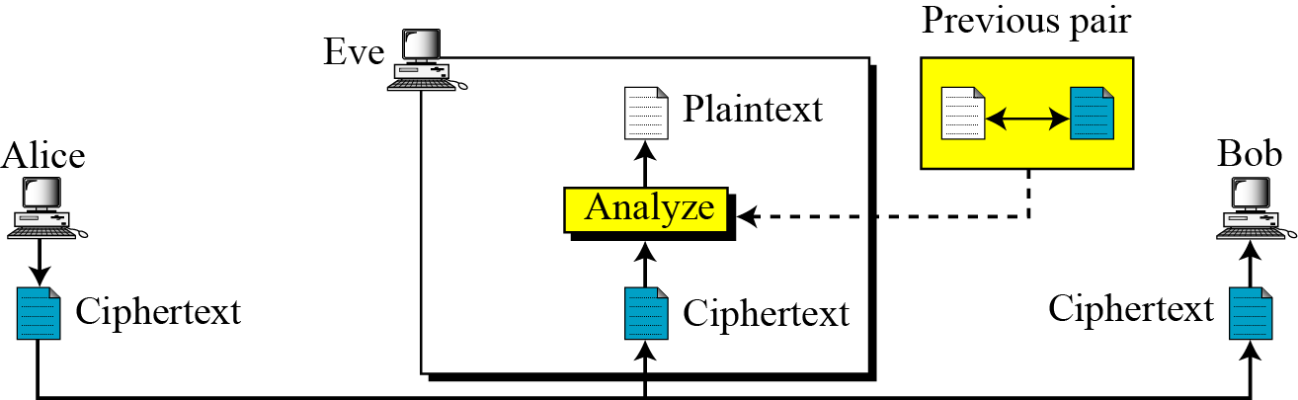
Attacks on Encrypted Messages
Type of Attack | Known to cryptanalyst
Known Plaintext | Encryption algorithm, Cipher text, One or more plaintext-cipher text pairs formed with the secret key
Attacks on Encrypted Messages^{[3]}

Slide 22
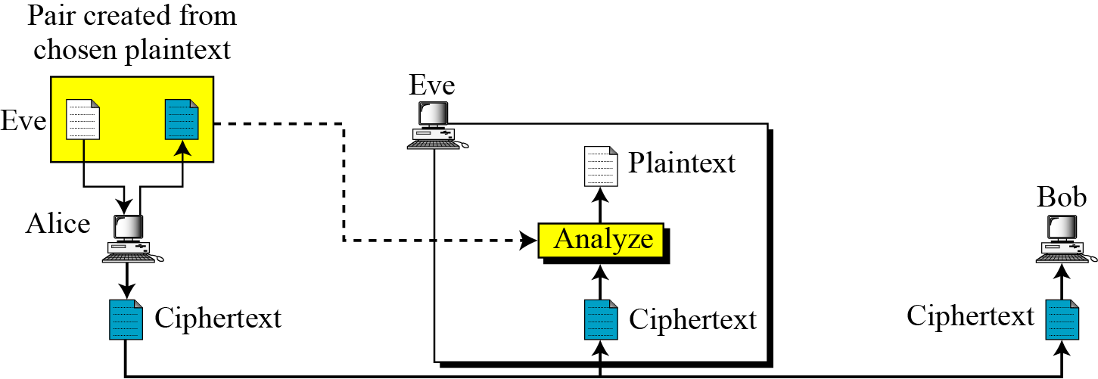
Attacks on Encrypted Messages
Type of Attack | Known to cryptanalyst
Chosen Plaintext | Encryption algorithm, Cipher text, Plaintext message chosen by cryptanalyst
Attacks on Encrypted Messages^{[3}}

Slide 23
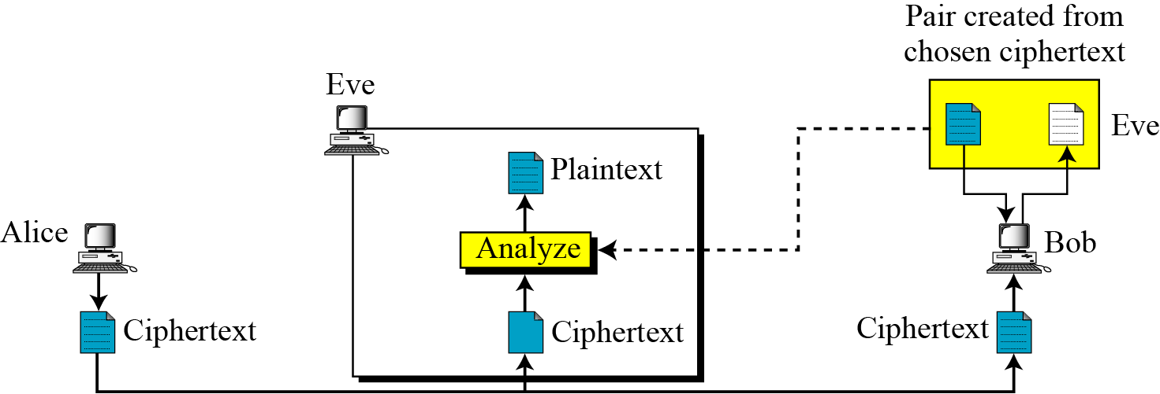
Attacks on Encrypted Messages
Type of Attack | Known to cryptanalyst
Chosen Cipher text | Encryption algorithm, Cipher text, Cipher text chosen by cryptanalyst, with its corresponding decrypted plaintext generated with the secret key
Attacks on Encrypted Messages^{[3}}

Slide 24
Attacks on Encrypted Messages
Type of Attack | Known to cryptanalyst
Chosen text | Encryption algorithm, Cipher text, Plaintext chosen by cryptanalyst, with its corresponding cipher text generated with the secret key , Cipher text chosen by cryptanalyst, with its corresponding decrypted plaintext generated with the secret key

Slide 25
Unconditional Security
An encryption scheme is unconditionally secure if the cipher text generated by the scheme does not contain enough information to determine uniquely the corresponding plaintext, no matter how much cipher text is available.
That is, no matter how much computer power or time is available, the cipher cannot be broken since required information is not there.

Slide 26
Unconditional Security
There is no encryption algorithm that is unconditionally secure except one-time pad. So,
The cost of breaking cipher exceeds the value of encrypted information
The time required to break cipher exceeds the useful lifetime of the information

Slide 27
Computational Security
An encryption scheme is said to be computationally secure if either of the following two criteria are met.
The cost of breaking the cipher exceeds the values of the encrypted information.
The time required to break the cipher exceeds the useful lifetime of the information.

Slide 28
Symmetric key cryptography
An original message is known as the plaintext, while the coded message is called the cipher text.
The process of converting from plaintext to cipher text is known as encryption or enciphering.
Restoring the plaintext from the cipher text is known as decryption or deciphering.
Techniques used for deciphering a message without any knowledge of the enciphering details fall into the area of cryptanalysis.

Slide 29
Symmetric key cryptography
Symmetric encryption is a form of cryptosystem in which encryption and decryption are performed using the same key. It is also known as conventional encryption.
Symmetric encryption transform plaintext into cipher text using a secret key and an encryption algorithm.
Using the same key and a decryption algorithm, the plaintext is recovered from the cipher text.

Slide 30
Classical Encryption Techniques
The two basic building blocks of all encryption techniques are
Substitution Techniques
In this the letters of plaintext are replaced by other letters or by numbers or symbols
Transposition Techniques
Performs some sort of permutation on the plaintext letters
Rearrangement of plaintext to produce cipher text

Slide 31
Substitution Techniques
A substitution technique is one in which the letters of plaintext are replaced by other letters or by numbers or symbols.
Caesar Cipher
Monoalphabetic Cipher
Playfair Cipher
Hill Cipher
Polyalphabetic Ciphers
One-Time Pad

Slide 32
1) Caesar Cipher
The Caesar cipher involves replacing each letter of the alphabet with the letter standing three places further down the alphabet.
In encryption each plaintext letter P, substitute the cipher text letter C:
For decryption algorithm is:
C = E(k, P) = (P + k) mod 26
C = E(3, P) = (P + 3) mod 26
P = D(k, C) = (C - k) mod 26

Slide 33
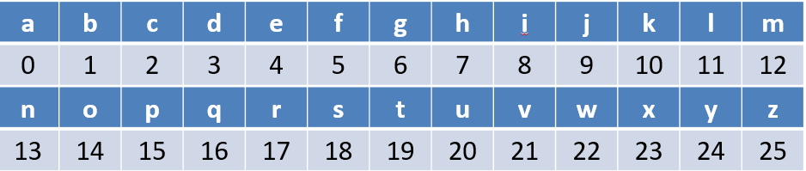
Caesar Cipher
Let us assign a numerical equivalent to each letter
plain: a b c d e f g h i j k l m n o p q r s t u v w x y z
cipher: d e f g h i j k l m n o p q r s t u v w x y z a b c
C = E(3, P) = (P + 3) mod 26

Slide 34
Caesar Cipher
Example:
Plain text: T H E Q U I C K B R O W N F O X
Cipher text: W K H T X L F N E U R Z Q I R A

Slide 35
Brute force attack on Caesar Cipher
The encryption and decryption algorithms are known.
There are only 25 keys to try.
The language of the plaintext is known and easily recognizable.

Slide 36
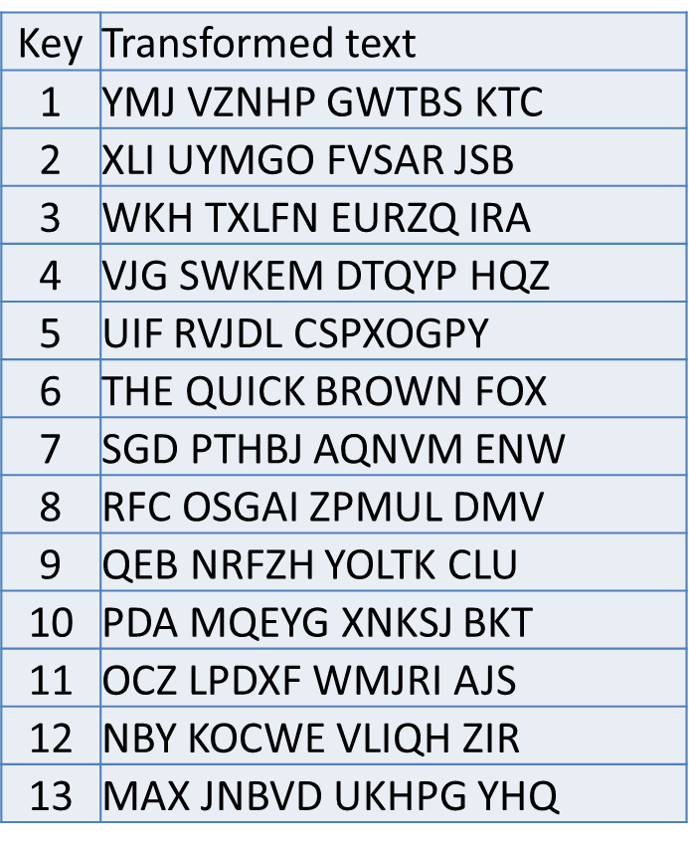
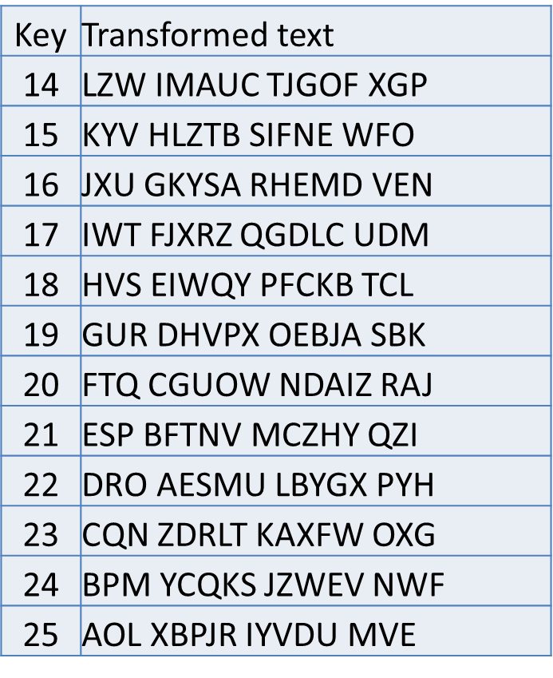
Brute force attack on Caesar Cipher
Cipher text: ZNK WAOIQ HXUCT LUD
Brute force attack on Caesar cipher^{[3]}
Brute force attack on Caesar cipher^{[3]}

Slide 37
Substitution Techniques
Caesar Cipher
Monoalphabetic Cipher
Playfair Cipher
Hill Cipher
Polyalphabetic Ciphers
One-Time Pad

Slide 38
2) Monoalphabetic Cipher (Simple substitution)
It is an improvement to the Caesar Cipher.
Instead of shifting the alphabets by some number, this scheme uses some permutation of the letters in alphabet.
plain: a b c d e f g h i j k l m n o p q r s t u v w x y z
cipher: y n l k x b s h m i w d p j r o q v f e a u g t z c

Slide 39
2) Monoalphabetic Cipher (Simple substitution)
The sender and the receiver decide on a randomly selected permutation of the letters of the alphabet.
With 26 letters in alphabet, the possible permutations are 26! which is equal to 4x1026.

Slide 40
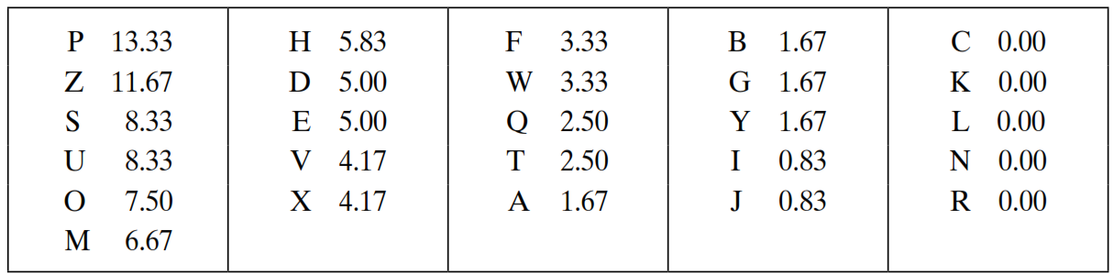
Attack on Monoalphabetic Cipher
The relative frequencies of the letters in the cipher text (in percentages) are
Attack on Mono alphabetic cipher^{[3]}

Slide 41
Attack on Monoalphabetic Cipher
Cipher text:
Uzqsovuohxmopvgpozpevsgzwszopfpesxudbmetsxaizvuephzhmdzshzowsfpappdtsvpquzwymxuzuhsxepyepopdzszufpombzwpfupzhmdjudtmohmq
In our cipher text, the most common digraph is ZW, which appears three times. So equate Z with t, W with h and P with e.
Now notice that the sequence ZWP appears in the ciphertext, and we can translate that sequence as “the.”

Slide 42
Attack on Monoalphabetic Cipher
If the cryptanalyst knows the nature of the plaintext, then the analyst can exploit the regularities of the language.
The relative frequency of the letters can be determined and compared to a standard frequency distribution for English.
If the message were long enough, this technique alone might be sufficient, but because this is a relatively short message, we cannot expect an exact match.

Slide 43
Substitution Techniques
Caesar Cipher
Monoalphabetic Cipher
Playfair Cipher
Hill Cipher
Polyalphabetic Ciphers
One-Time Pad

Slide 44
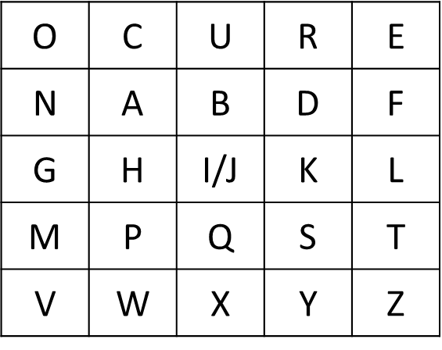
3) Playfair Cipher
The Playfair algorithm is based on a 5 × 5 matrix (key) of letters.
The matrix is constructed by filling in the letters of the keyword (minus duplicates) from left to right and from top to bottom, and then filling in the remainder of the matrix with the remaining letters in alphabetic order. The letters I and J count as one letter.
Example:
Keyword= OCCURRENCE
Plaintext= TALL TREES
Play fair cipher ^{[3]}

Slide 45
Playfair Cipher - Encrypt Plaintext
Playfair, treats digraph (two letters) in the plaintext as single units and translates these units into cipher text digraph.
Make Pairs of letters add filler letter “X” if same letter appears in a pair.
Plaintext= TALL TREES
Plaintext= TA LX LT RE ES
If there is an odd number of letters, then add uncommon letter to complete digraph, a X/Z may be added to the last letter.

Slide 46
Playfair Cipher - Encrypt Plaintext
Map each pair in key matrix
If the letters appear on the same row, replace them with the letters to their immediate right respectively, wrapping around to the left side of the row if necessary.
If the letters are on different rows and columns, replace them with the letters on other corner of the same row.
The order is important - the first letter of the pair should be replaced first.
Cipher text= PF IZ TZ EO RT

Slide 47
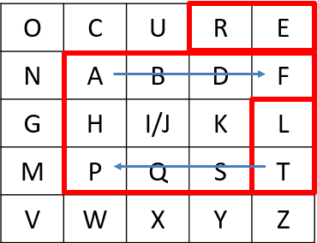
Playfair Cipher - Encrypt Plaintext
For example, using the table above, the letter pair TA would be encoded as PF.
Plaintext= TA LX LT RE ESthe letters appear on the same column, replace them with the letters immediately below, wrapping around to the top if necessary.
For example, using the table above, the letter pair LT would be encoded as TZ.
Play fair cipher^{[3}}

Slide 48
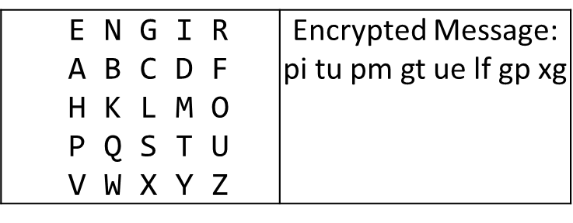
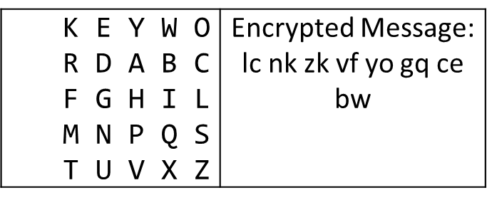
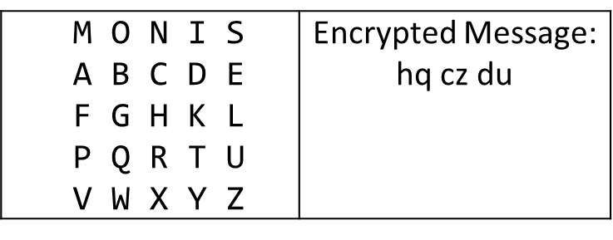
Play fair Cipher Examples
Key= “ engineering ” Plaintext=” test this process ”
Key= “ keyword ” Plaintext=” come to the window ”
Key= “ moonmission ” Plaintext=” greet ”
Play fair cipher^{[3}}
Play fair cipher^{[3}}
Play fair cipher^{[3}}

Slide 49
Substitution Techniques
Caesar Cipher
Monoalphabetic Cipher
Playfair Cipher
Hill Cipher
Polyalphabetic Ciphers
One-Time Pad

Slide 50
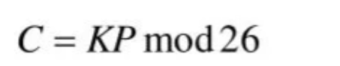
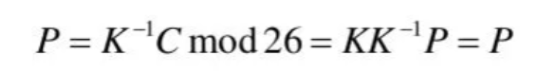
4) Hill Cipher
Hill cipher is based on linear algebra
Each letter is represented by numbers from 0 to 25 and calculations are done modulo 26.
Encryption and decryption can be given by the following formula:
Encryption:
Decryption:

Slide 51
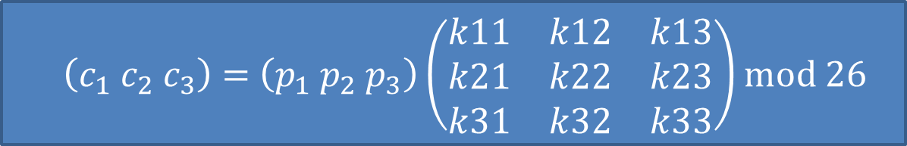
4) Hill Cipher

Slide 52
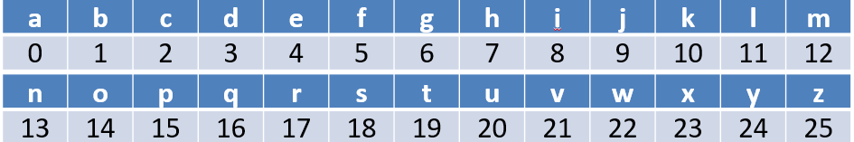
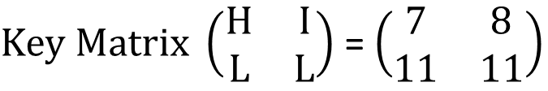
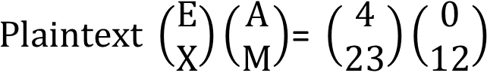
Hill Cipher Encryption
To encrypt a message using the Hill Cipher we must first turn our keyword and plaintext into a matrix (a 2 x 2 matrix or a 3 x 3 matrix, etc. ).
Example: Key = “HILL”, Plaintext = “EXAM”

Slide 53
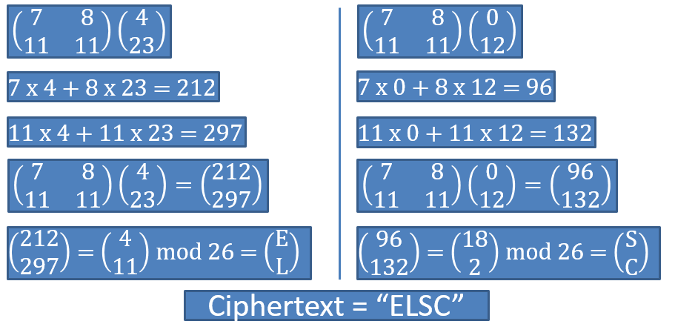
Hill Cipher Encryption

Slide 54
Hill Cipher Decryption
Step:1 Find Inverse of key matrix
Step:2 Multiply the Multiplicative Inverse of the Determinant by the Adjoin Matrix
Step:3 Multiply inverse key matrix with cipher text matrix to obtain plaintext matrix

Slide 55
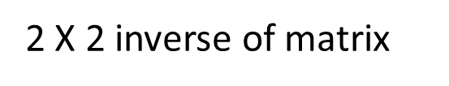
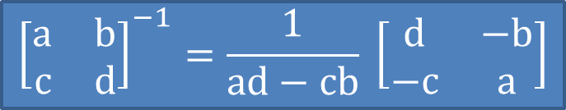
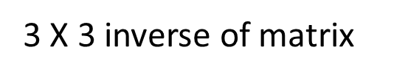
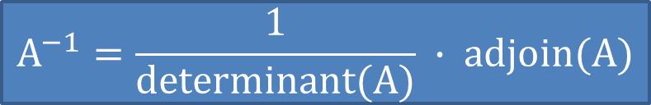
Step: 1 Inverse of key matrix

Slide 56
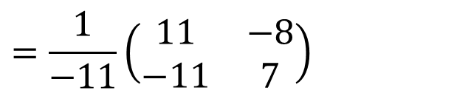
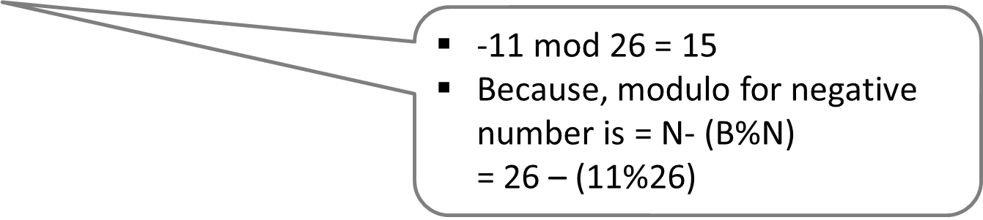
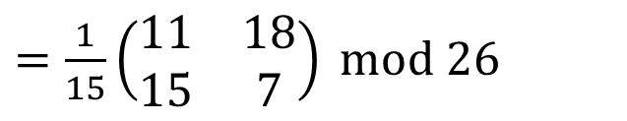
Step: 1 Inverse of key matrix

Slide 57
Step: 2 Modular (Multiplicative) Inverse
The inverse of a number A is 1/A since A * 1/A = 1
e.g. the inverse of 5 is 1/5
In modular arithmetic we do not have a division operation.
The modular inverse of A (mod C) is A⁻¹
(A * A⁻¹) ≡ 1 (mod C)

Slide 58

Step: 2 Modular (Multiplicative) Inverse
Example:
The modular inverse of A mod C is the A⁻¹ value that makes
A * A⁻¹ mod C = 1
A = 3, C = 11
Since (3*4) mod 11 = 1, 4 is modulo inverse of 3
A = 10, C = 17 , A⁻¹ = ?

Slide 59
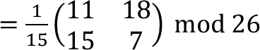
Step: 2 Modular (Multiplicative) Inverse
Determinants’ multiplicative inverse Modulo 26
Determinant | 1 | 3 | 5 | 7 | 9 | 11 | 15 | 17 | 19 | 21 | 23 | 25
Inverse Modulo 26 | 1 | 9 | 21 | 15 | 3 | 19 | 7 | 23 | 11 | 5 | 17 | 25

Slide 60
Step: 3 Multiply with adjoin of matrix

Slide 61
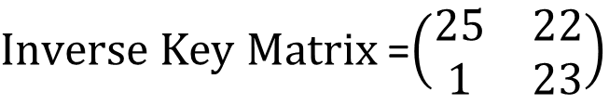
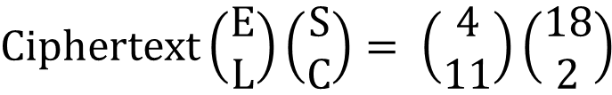
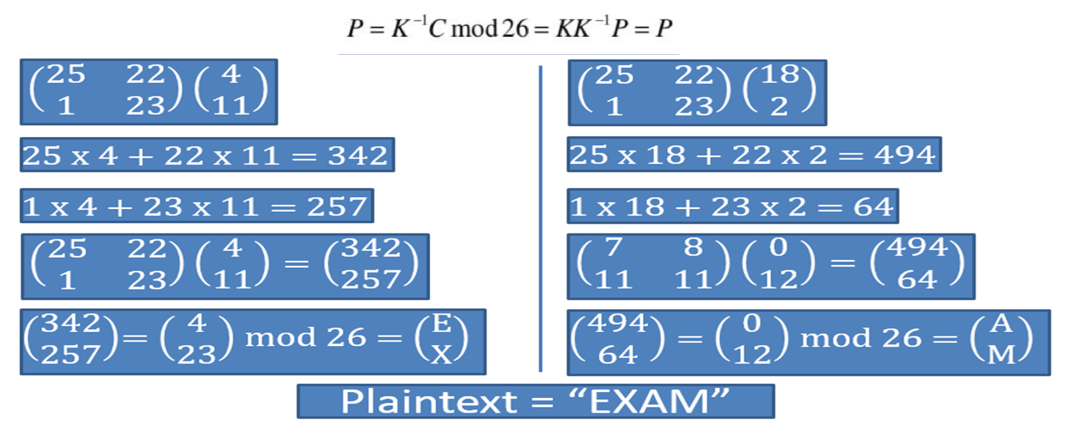
Hill Cipher Encryption

Slide 62
Substitution Techniques
Caesar Cipher
Monoalphabetic Cipher
Playfair Cipher
Hill Cipher
Polyalphabetic Ciphers
One-Time Pad

Slide 63
5) Polyalphabetic Cipher
Mono alphabetic cipher encoded using only one fixed alphabet.
Polyalphabetic cipher is a substitution cipher in which the cipher alphabet for the plain alphabet may be different at different places during the encryption process.
Vigenere cipher
Vernam cipher

Slide 64
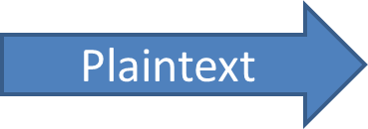
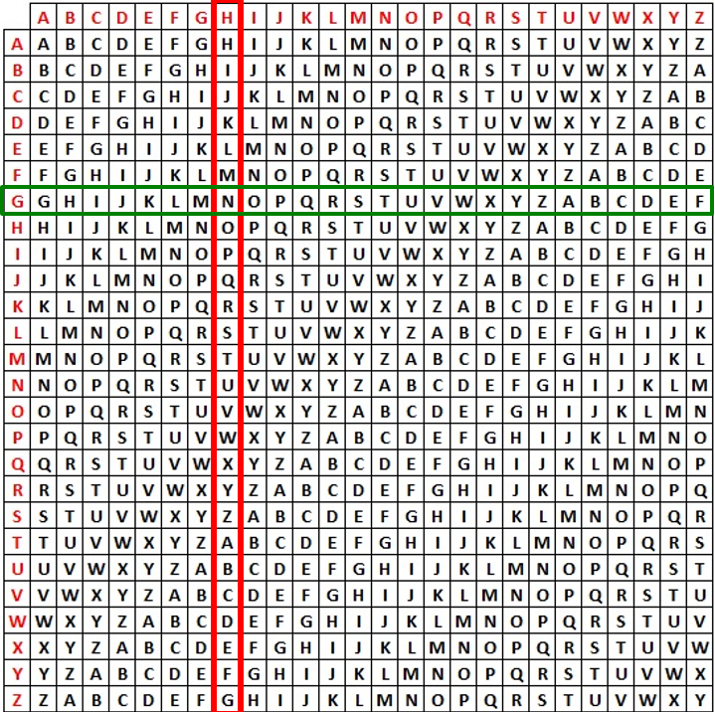

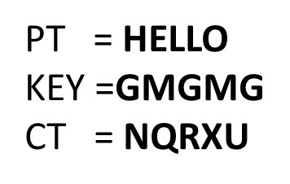
5) Polyalphabetic Cipher
Polyalphabetic cipher^{[3]}

Slide 65
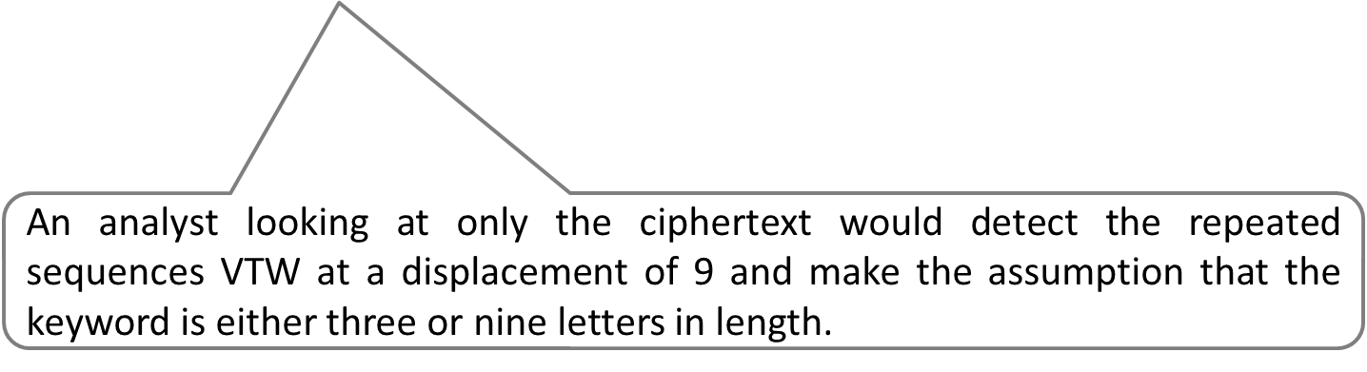
Vigenere Cipher
Keyword : DECEPTIVE
Key : DECEPTIVEDECEPTIVEDECEPTIVE
Plaintext : WEAREDISCOVEREDSAVEYOURSELF
Cipher text : ZICVTWQNGRZGVTWAVZHCQYGLMGJ

Slide 66
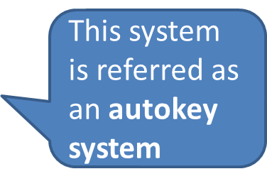
Vigenere Cipher
Keyword : DECEPTIVE
Key : DECEPTIVEDECEPTIVEDECEPTIVEDE
Plaintext : WEAREDISCOVEREDSAVEYOURSELF

Slide 67
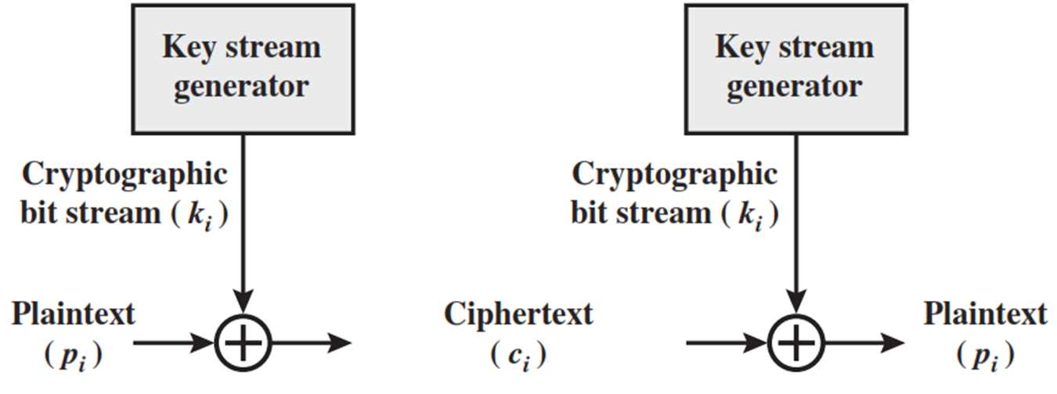
Vernam Cipher
The cipher text is generated by applying the logical XOR operation to the individual bits of plaintext and the key stream.
Vernam cipher^{[3]}

Slide 68
Substitution Techniques
Caesar Cipher
Monoalphabetic Cipher
Playfair Cipher
Hill Cipher
Polyalphabetic Ciphers
One-Time Pad

Slide 69
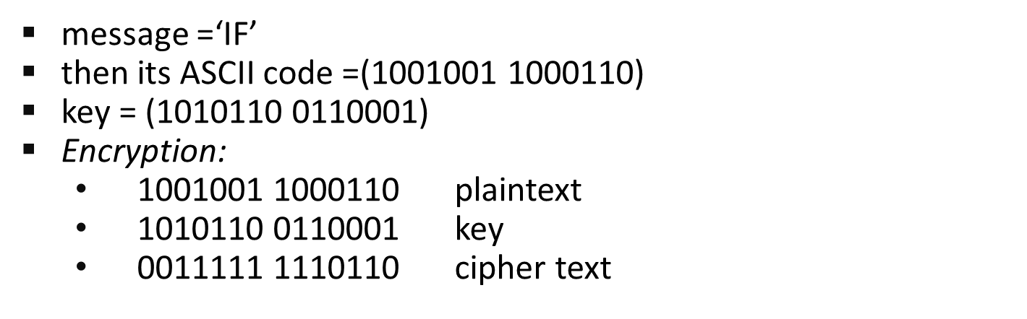
One time pad
The one-time pad, which is a provably secure cryptosystem, was developed by Gilbert Vernam in 1918.
The message is represented as a binary string (a sequence of 0’s and 1’s using a coding mechanism such as ASCII coding.
The key is a truly random sequence of 0’s and 1’s of the same length as the message.

Slide 70
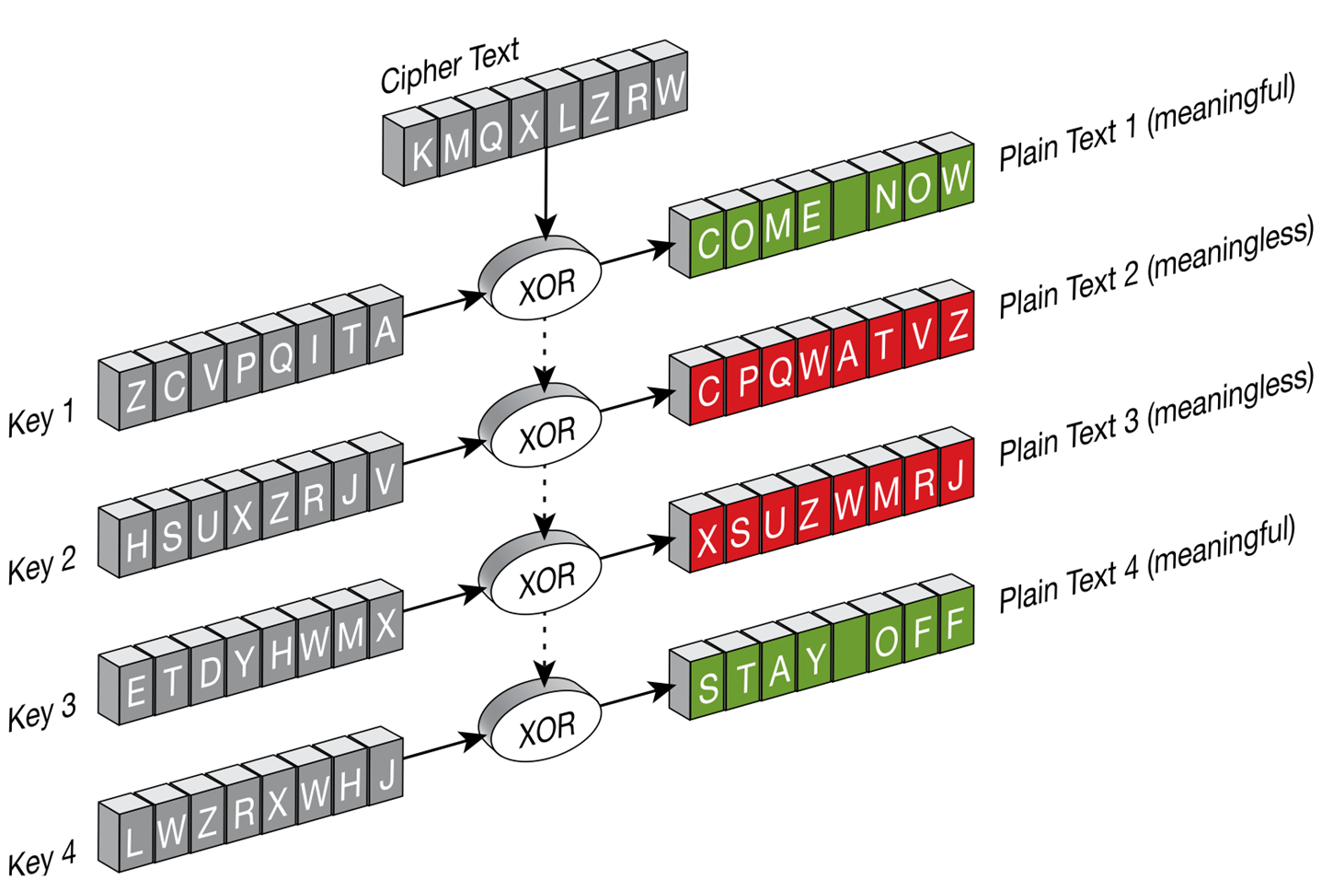
One time pad
One time pad^{[3]}

Slide 71
Transposition Techniques
A transposition cipher does not substitute one symbol for another, instead it changes the location of the symbols.
The simplest such cipher is the rail fence technique, in which the plaintext is written down as a sequence of diagonals and then read off as a sequence of rows.
For example, to send the message “Meet me at the park” to Bob, Alice writes
She then creates the cipher text “MEMATEAKETETHPR”.
Transposition Techniques^{[3]}

Slide 72
Row column technique
A more complex scheme is to write the message in a rectangle, row by row, and read the message off, column by column, but permute the order of the columns.
The order of the columns then becomes the key to the algorithm.
Key: 4 3 1 2 5 6 7
1 2 3 4 5 6 7
Plaintext: a t t a c k p
o s t p o n e
d u n t i l t
w o a m x y z
Cipher text: TTNAAPTMTSUOAODWCOIXKNLYPETZ

Slide 73
Cryptography and Cryptanalysis
Cryptography and Cryptanalysis
Cryptography is the study of the design of techniques for ensuring the secrecy and/or authenticity of information
Cryptanalysis deals with the defeating such techniques to recover information, or forging information that will be accepted as authentic

Slide 74
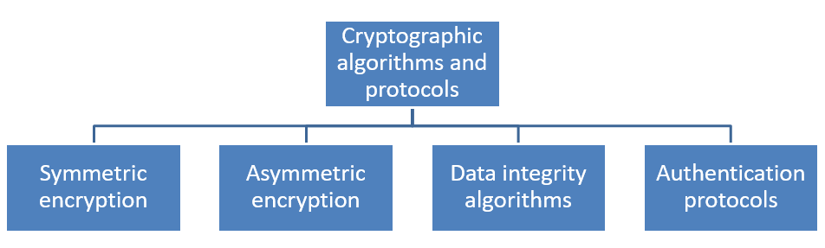
Cryptographic Algorithms
Cryptographic algorithms and protocols can be grouped into four main areas
Cryptographic Algorithms^{[3]}

Slide 75
Cryptographic Algorithms
Symmetric encryption used to secure the contents of blocks or streams of data of any size, including messages, files, encryption keys, and passwords
Asymmetric encryption used to conceal small blocks of data, such as encryption keys and hash function values, which are used in digital signatures.
Data integrity algorithms used to protect blocks of data, such as messages, from alteration
Authentication Protocols are schemes based on the use of cryptographic algorithms designed to authenticate the identity of entities.

Slide 76
Security Objectives
Security objectives for information and computing services are Confidentiality, Integrity, Availability, Authenticity, Accountability.
Confidentiality:
Data confidentiality: Assures that private or confidential information is not made available or disclosed to unauthorized individuals.
Privacy: Assures that individuals control what information related to them may be collected and stored and by whom and to whom that information may be disclosed.

Slide 77
Security Objectives
Integrity:
Data integrity: Assures that information and programs are changed only in a specified and authorized manner.
System integrity: Assures that a system performs its intended function in an unimpaired manner, free from deliberate or inadvertent unauthorized manipulation of the system.
Availability: Assures that systems work promptly and service is not denied to authorized users.

Slide 78
Security Objectives
Authenticity:
The property of being genuine and being able to be verified and trusted; confidence in the validity of a transmission, a message, or message originator.
This means verifying that each input arriving at the system came from a trusted source.
Accountability:
The security goal that generates the requirement for actions of an entity to be traced uniquely to that entity.
This supports nonrepudiation, deterrence, fault isolation, intrusion detection and prevention, and after-action recovery and legal action.

Slide 79
Threat and Attack
Threat: A potential for violation of security, which exists when there is a circumstance, capability, action, or event that could crack security and cause harm. That is, a threat is a possible danger that might exploit a vulnerability.
Attack: An violation on system security that derives from an intelligent threat; that is, an intelligent act that is a calculated attempt to avoid security services and violate the security policy of a system.

Slide 80
Steganography
Steganography is the art and science of writing hidden messages in such a way that no one apart from the sender & intended recipient knows of the existence of the message.
The word steganography is of Greek origin words steganos (στεγανός), meaning "covered or protected", and graphei (γραφή) meaning "writing".
Cryptography relies on transformation algorithms using key to scramble a message.

Slide 81
Steganography
Steganography takes one piece of information and hides it within another.
Both are used to protect information but steganography is concerned with hiding information thereby making it unseen while cryptography is concerned with encrypting information thereby making it unreadable.

Slide 82
Steganography
Some Examples:
Character marking: where selected letters of text are overwritten with a special pencil. The marks are ordinarily not visible unless the paper is held at an angle to bright light.
Use of invisible ink. Visible when some heat or chemical applied
Pin punctures. On selected letters visible in front of light

Slide 83
Steganography
Typewriter correction ribbon visible under strong light
Types of Steganography:
Audio steganography
Video steganography
Textual steganography
Image steganography
Network steganography

Slide 84
References
[1] Information Security Articles, References, & Blogs, UC SANTA BARBARA
https://www.it.ucsb.edu/general-security-resources/information-security-articles-references-blogs
[2] What is Information Security? cisco
https://www.cisco.com/c/en_in/products/security/what-is-information-security-infosec.html
[3] CRYPTOGRAPHY AND NETWORK SECURITY. Harlow: Tata McGraw-Hill.
[4] Nutt, G. J. (2004). Operating systems: A modern perspective. Boston: Pearson/Addison Wesley.
[5] Cyber Security Strategies. Tutorials point.
https://www.tutorialspoint.com/information_security_cyber_law/cyber_security_strategies.htm

Slide 85


www.paruluniversity.ac.in

